Slide 1
Welcome Back
Heavenly Ski & Ride School
2022-2023

Slide 2
Agenda
Welcome and Introductions
SRS Updates
Service
Your Safety
Your Pay
What’s Next

Slide 3
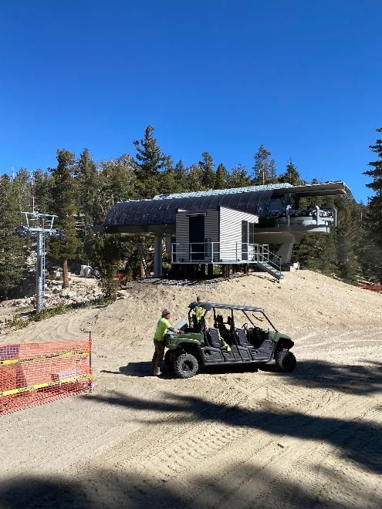
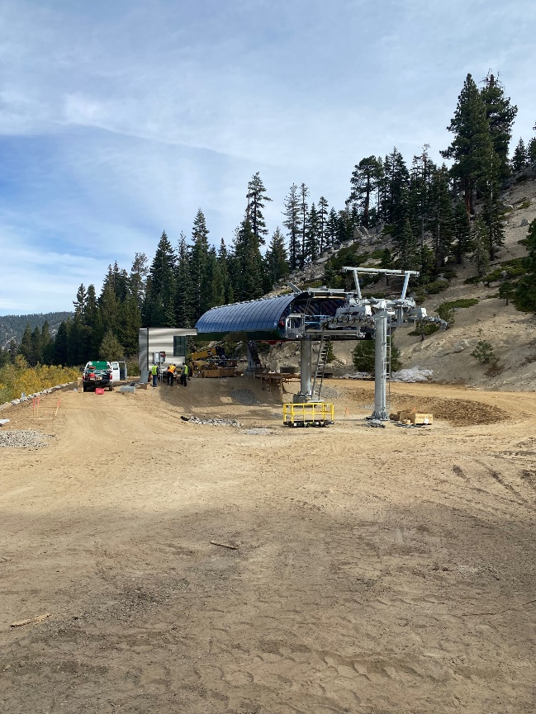
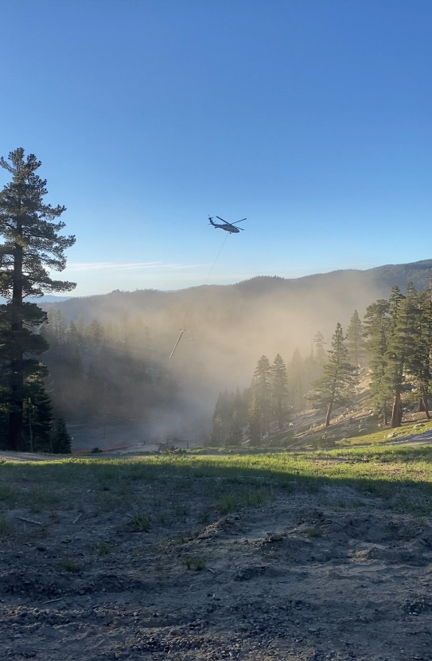
Welcome and Introductions
Hello from Robin
Who’s New/New to Their Role
Resort Updates
  Northbowl Express
  Guest Services/SRS/Season Passes
  California First
  Employee Daycare Discounts

Slide 4
SRS Updates
  Boulder – YES!!!
    Weekends/holidays – exact offering to be decided
  Call Center
  Green Run Guarantee – more to come via locations
    A conversion tool for new participants
    If guests cannot ski or snowboard a qualifying green run in three lessons, the fourth lesson is free
  3 and 4 year olds and Daycare Product Reimagine
    Cater to expanding demand in this guest demographic
    Cap number of Private Lesson guests at this age per lesson

Slide 5
Service
  In a company-wide email, this summer CEO Kirsten Lynch reflected that Vail Resorts could not fulfill its goal to provide guests with the Experience of a Lifetime without first providing that to staff, and acknowledged that the company had
    “fallen short on that.” “Addressing this,” she said, “requires a pivotal shift in our company’s direction with a new strategic focus on all of you—year-round and seasonal, hourly and salaried, mountain resorts and corporate.”
  Happy Excited Welcome Safe: HEWS
  We want to WELCOME everyone to Heavenly Ski and Ride School

Slide 6
Safety
Safety Training Log
Safety Business Plan

Slide 7
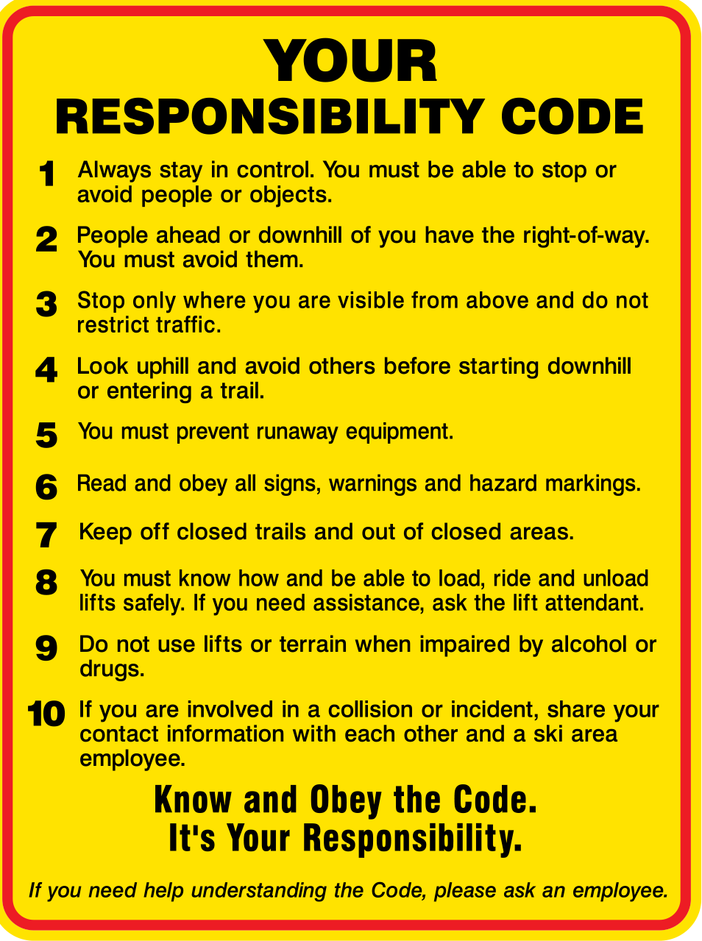

Slide 8

A Decision Making Model
Stop: Stop long enough to think about what you're about to do.
Think: Take the time to THINK about how you are going to do it.
Options: Is it the safest way? If not, how can you do it better?
Power: You have the POWER to act in the safest way possible.
Notes:
If you can just get yourself and your staff to think for only a few seconds before doing anything, you can prevent a lot of injuries. Look at Stop, Think, Options, Power as an opportunity to do things better and smarter. The time you save by acting impulsively is minuscule compared to the potential consequences.
Sometimes we think of Stopping only when we see a Red Flag. Encourage your teams to stop even when we see yellow flags, or when no apparent danger is present. Stopping first before any action can help us create a pattern of looking for potential risks and assessing the safest way forward.
Practical Application: Use the following scenario, or discuss one that applies closely to your resort or experience.
You are running private lesson lineup. Annie, one of your top instructors has called in sick. Annie was supposed to be skiing with her top client, who happens to be a high net worth guest and spends more dollars at your resort than any other guest.
Annie has skied with them for 10 years. The family knows the resort well and can ski most of the advanced terrain at the resort with confidence. Their competence in doing so varies day to day and with conditions.
Normally, if Annie were sick or unavailable, the family would take a day off from the lesson. In this case, there has not been a lot of snow yet in this early part of the season. It snowed 8 inches last night and the mountain will be busy today. They would like priority lift access and prefer to ski the steeper areas and trees, because of the new snow.
It is known by many that the family tips very well if the instructor meets their expectations for the day.
Your Available Instructors.
Who do you choose and why?
What conflicting values exist for you as you make your decision?
How will you use the STOP model in making your decision?
1. What conflicting values will there be for the instructor you have chosen?
2. How will you address these conflicting values with the instructor?
3. What conversation do you have with this instructor about the guest, the current terrain available and how to best manage their day?
4. How will the STOP model be useful for this instructor?
5. How will you discuss the STOP model with this instructor?

Slide 9
Your Pay
How To Record Hours and Incentives
Teach, Non-Teach, and Training Hours
Timecard: SmartSheet Form
How To Access: https://vailresorts.servicenow.com/hrportal?id=srs_redir&sysparm_options=redirect
KB0032239 | How to use the SRS Smartsheet
Required to be submitted on the day you work
Record all hours worked
  Teach, Non-Teach, and Training Hours
  Required Training including required LIFT Training
  Acknowledge opportunity for breaks
Incentives and Additional Pay
Headcount, Firecrackers/Blasters, Returners, Requests, etc
Rates are the same-refer to the SRS Resource & Guideline Manual
Recorded on check out sheet
Verified by you and your Supervisor

Slide 10
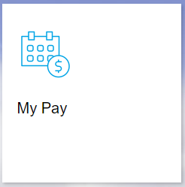
How to Verify Your Pay
Instructor.snow.com
Check daily activity pay that has been entered into the system
Pass Number: Enter your pass # (the 10 digit number located underneath your employee photo) and click Logon.
Password: $noW2223 (S = $ and the W is capitalized)
Epic Employee
Pay Statements
Over-time
Tax Deductions
Benefit Deductions
Meal/Break Penalty Pay
Reimbursements

Slide 11
Other Resources
Epic Employee
Direct Connect-Learn & Get Help (Knowledge Based Articles)
Direct Connect-Take Action
  Check Stubs
  Tax Documents
  Update Contact Information
  Required Notices: Employee Guide/Team Member Handbook
    Link To Policy Tech
Heavenlysrs.com
SRS Resource & Guidelines Manual Links
Information on SRS Pay Structure & Incentives
SRS Newsletters
Guest Comments

Slide 12
What Now?
Opening Date – Friday November 18 in California
Connect with Location Leadership
Uniforms – California Kids lobby
Lockers – Available on Monday November 14
Equipment Checks – See Your Location Managers
Helmets – Uniform Room Monday though Friday
Nametags – We will send a link
40% Employee Discount – Heavenly Sports is open in the CA Lodge

Slide 13
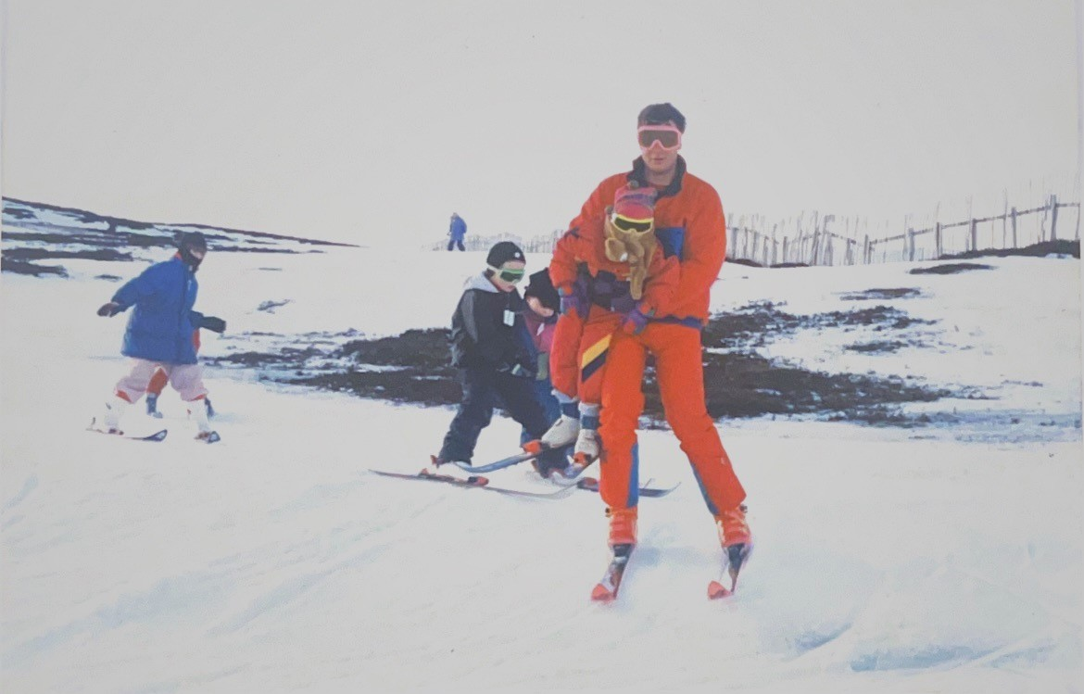
Thank you and think snow!
This is how not to do it:

